Slide 2
Go Reactive with Reactive Extensions and ReactiveUI
Rodney Littles, II

Slide 3
I’m Rodney
Twitter - https://twitter.com/rlittlesii
Twitch - https://www.twitch.tv/rlittlesii/
GitHub – https://github.com/RLittlesII
Notes:
I am a maintainer of ReactiveUI
I am a .NET Foundation member
I am a Microsoft MVP
Today I will be talking about Reactive Extensions, ReactiveUI and why you want to use them in mobile applications
I am going to start with
A brief history lesson
Some concerns that mobile developers face
Demos
Shameless plug
Give you some take aways

Slide 4
.NET 3.5
Rx .NET
ReactiveUI
2007
2009
2010
Notes:
LINQ
.NET 3.5 Brought LINQ
C# first step towards adding functional elements to the language
LINQ allows you to apply SQL style functions over collections
Objects
SQL
XML
Rx .NET
Eric Meijer and Wes Dyer broke the world
While working at Microsoft they stumbled upon a monad
Pull based and Push based collections
ReactiveUI
Anais Betts created some extension methods that was the basis for ReactiveUI and MVVM framework for .NET Applications
System.Reactive
.NET Reactive Extensions implementation

Slide 5
public interface IObserver<in T>
{
void OnCompleted();
void OnError(Exception error);
void OnNext(T value);
}
public interface IEnumerator { object Current { get; } bool MoveNext(); void Reset(); }
public interface IObservable<out T> { IDisposable Subscribe(IObserver<T> observer); }
public interface IEnumerable<out T> { IEnumerator<T> GetEnumerator(); }
Notes:
These interfaces are defined in the System namespace, and are a first class citizen in .NET
- IEnumerator
Current - The current node the enmuerator is iterating over
MoveNext - Tells the enumerator to evaluate the next item in the list
Reset - Tells the enumerator to start from its initial position
IEnumerable
Pull based collection
Pulls a certain amount
Does not change unless explicitly mutated
* If you've ever seen the yellow squiggly that tells you "Multiple possible enumerations", it happens because if the state of the list the enumerator is traversing, it will automatically call Reset and start from the beginning.
- IObservable
OnCompleted – a notification that the stream is terminating and no more values are coming
OnError – If an error is generated on the stream, this allows you to process the error
OnNext – Handles the next value coming down the stream
IObservable
Push based collection
This works well with technologies like
SignalR
Real Time Events
Subcribe - How you get the observer to read values from the observable
Gang Of Four Publish Subscribe Pattern
Twitter stream is a great example of an Observable
You have many people watching the stream
The stream constantly has new data pushed to it
All subscribers have the opportunity to act on any value pushed to the stream (tweet)

Slide 6


!=
Notes:
I know you’re going to tell me “Rodney, that Rx stuff is pure wizardy”
I’ve had people tell me “that looks like magic.”
I agree. It is magic!
Composable
You can compose parts of queries, and branch various observers to do different things at different points in the query execution
Declarative
Reactive
Readable
Reactive Extensions are across languages
Java
Go
Swift
JavaScript
Kotlin
PHP, even PHP
Reactive Extensions is really all about collections

Slide 7
Conveyor Belt

Slide 8
What’s this got to do with Xamarin and Mobile?
As mobile developers, we …
Respond to Events
Avoid Memory Leaks
Asynchronously load data
Handle disconnected state
Notes:
Events
As mobile developers we are constantly using commanding to create event handler that do some work in our view models
Memory Leaks
Limited resources
Managed Runtime
iOS memory crashes applications
Recommended we memory profile with Xamarin Profiler before every release, but who does that?! Just wait for the inevitable crash!
Loading data Asynchronously
Load data on page load
No global application state
Disconnected State
No internet
Responding to when the state changes

Slide 9
Have you ever seen …
SearchBar.TextChanged += (sender, args) => { };
Notes:
This is a delegate that is not cached
Delegates that aren’t cached cannot be disposed of properly
Because there is not explicit reference in memory to the handler, the garbage collector won't reclaim the memory

Slide 10

Leads to …
Notes:
These are the three main things we as developers need when handling events
Event Handlers
Callback
Deallocation
Deallocation is the one I think we fail at the most. How do we properly dispose of objects?

Slide 11
What If …
textChangedEvents
.Throttle(TimeSpan.FromMilliseconds(750), RxApp.TaskpoolScheduler) .Select(x => x.NewTextValue.Trim()) .DistinctUntilChanged() .Where(x => !string.IsNullOrWhiteSpace(x)) .ObserveOn(RxApp.MainThreadScheduler) .InvokeCommand(this, x => x.ViewModel.Search) .DisposeWith(ViewBindings);
Notes:
System.Reactive provides a way to convert Events to Observables.
This is effectively becomes LINQ over Events.
I can delay processing on a set of events
I can tell it to process away from the main thread
I can only process new state
I can filter state
I can invoke a delegate
I can dispose with the view disposal
What if I told you EventHandler, Callback, and deallocation is encapsulated in textChangedEvents, which is conveniently not show here?
What if I told you this is all it takes to implement a simple search?
When I was told this, I thought people were crazy!

Slide 12
Demo intro slide

Slide 13
Observables
Are
Asynchronous
Awaitable
Disposable
They
Return an IDisposable
Allow you to batch disposal
Dispose of handlers when disposed
Notes:
Asynchronous
The can be used to model C# asynchronous methods
alternative to async/await
Can be scheduled on specific threads
They emit values over time
Awaitable
You can use async/await syntax with observables
Pay attention to threading
This can sometimes cause threads to be lost if you aren’t diligent about
Disposable
Observables return and IDisposable
Makes them ideal for garbage collection
Can use a composite disposable to clean subscriptions up in batch
Reactive Extensions provide an alternative way to model asynchronous programming. Async/await is the Task Parallel Library, C#’s way of modeling asynchronous actions. Prior to that it was the wild west. We had callbacks, command delegates and spaghetti everywhere.

Slide 14
How many times have you …
Loaded data asynchronously?
Loaded data when the Page/ViewModel is created?
Loaded a ListView with data?
Notes:
ReactiveUI has an interesting story for loading data
No need for async void, it’s bad don’t use it
No need for async in the constructor
We can load data into the view model in response to view model creation
DynamicData has an interesting story for ViewModel creation
Provides List and Dictionary style collections
Propogate changes based on ChangeSets of items
Supports standard LINQ operators
Has custom filter and transformation operators

Slide 15
Demo intro slide

Slide 16


Slide 17
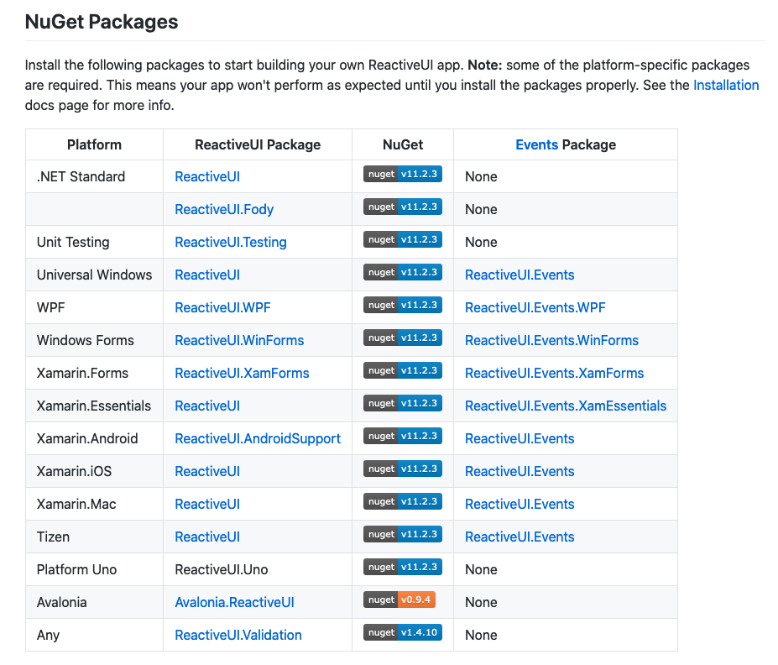
Notes:
We support all of the following platforms

Slide 18






Notes:
ReactiveUI
Just MVVM niceties on top of your UI kit
Most of the magic comes from, and is built using of Reactive Extensions
Better understanding Reactive Extensions will help your understanding of how to get more value using of ReactiveUI
Pharmacist
Clean way to cut down on boiler plate code
Works at compile time
Makes wrapping events in Observable streams easy so you can use LINQ to Events
Dynamic Data
What I thought ObservableCollection should have been when I first started using it
Allows for further encapsulation of data logic to be lifted from the ViewModel
Is a clean and composable way to handle lists of data over time
The main thing I see
People want to use ReactiveUI without adopting Reactive Programming
People won’t approach it because it’s Functional
Once you unlock the power, you will want to do more
The biggest misunderstanding
ReactiveUI not the same as React
ReactiveUI is an MVVM framework built on Reactive Extensions
You can use ReactiveUI without Reactive Extensions, but you are leaving value the framework provides on the table
You can use Reactive Extensions and not ReactiveUI
A difficult change
Defining all your logic in the constructor
Even though we say we want clean code, really we prefer it spread out all over the file
Handlers here; Callbacks there; Maybe even some region tags
Defining the code in the constructor allows a single source of truth

Slide 19

https://reactiveui.net/book
https://github.com/kentcb

Slide 20
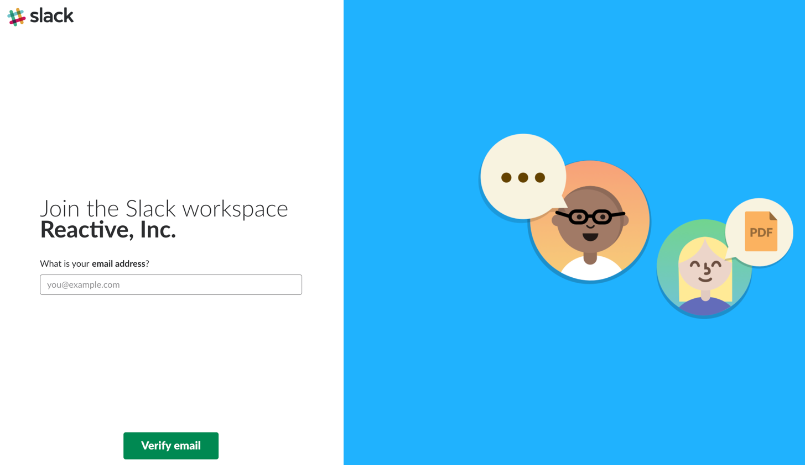
https://reactiveui.net/slack
Notes:
Take Away
Use Dynamic Data to load data and transform data
Use Pharmacist to generate events for you to reduce boiler plate code
Don’t fear observables, just use them as Linq to events to get started
It’s like pringles, once you start, the fun doesn’t stop!

